Slide 1
Errors, Effect Size and Power

Slide 2
Confidence intervals For the Regression coefficients*
*We made it!

Slide 3
Why did I burden you with all this information?
Our regression coefficients, divided by their standard errors, are also distributed as t variables
Degrees of freedom: n – 2 (in simple linear regression, because we have to account for the 2 coefficients we estimated from the sample data: the intercept + the slope)
We typically call the quantile our t_{crit}.
In our example, the t_{crit} quantile is (df = n – 2 = 926):
> qt(.975, df = n - 2) # + or -
[1] 1.962529

Slide 4
Is the slope different from zero?
What is β₁ under the null hypothesis?

Slide 5
What is the 95% confidence interval?
i.e., 𝝰 = .05:
qt(.975, df = n - 2)
Mainly of interest for slope, not so much intercept

Slide 6
> fitheight <- lm(child ~ parent, data = galton)
> # summary(fitheight)
> coefs_t <- tidy(fitheight) %>%
+ mutate(t = estimate/std.error)
> coefs_t
term estimate std.error statistic p.value t
1 (Intercept) 23.9415302 2.81087834 8.517455 6.536845e-17 8.517455
2 parent 0.6462906 0.04113588 15.711115 1.732509e-49 15.711115
> coefs_conf <- tidy(fitheight, conf.int = TRUE) %>%
> coefs <- tidy(fitheight, conf.int = TRUE)
> coefs_conf <- coefs %>%
+ mutate(lower = estimate + qt(.025, df = n - 2)*std.error,
+ upper = estimate + qt(.975, df = n - 2)*std.error)
> coefs_conf
term estimate std.error statistic p.value conf.low conf.high lower upper
1 (Intercept) 23.9415302 2.81087834 8.517455 6.536845e-17 18.4250996 29.4579608 18.4250996 29.4579608
2 parent 0.6462906 0.04113588 15.711115 1.732509e-49 0.5655602 0.7270209 0.5655602 0.7270209

Slide 7
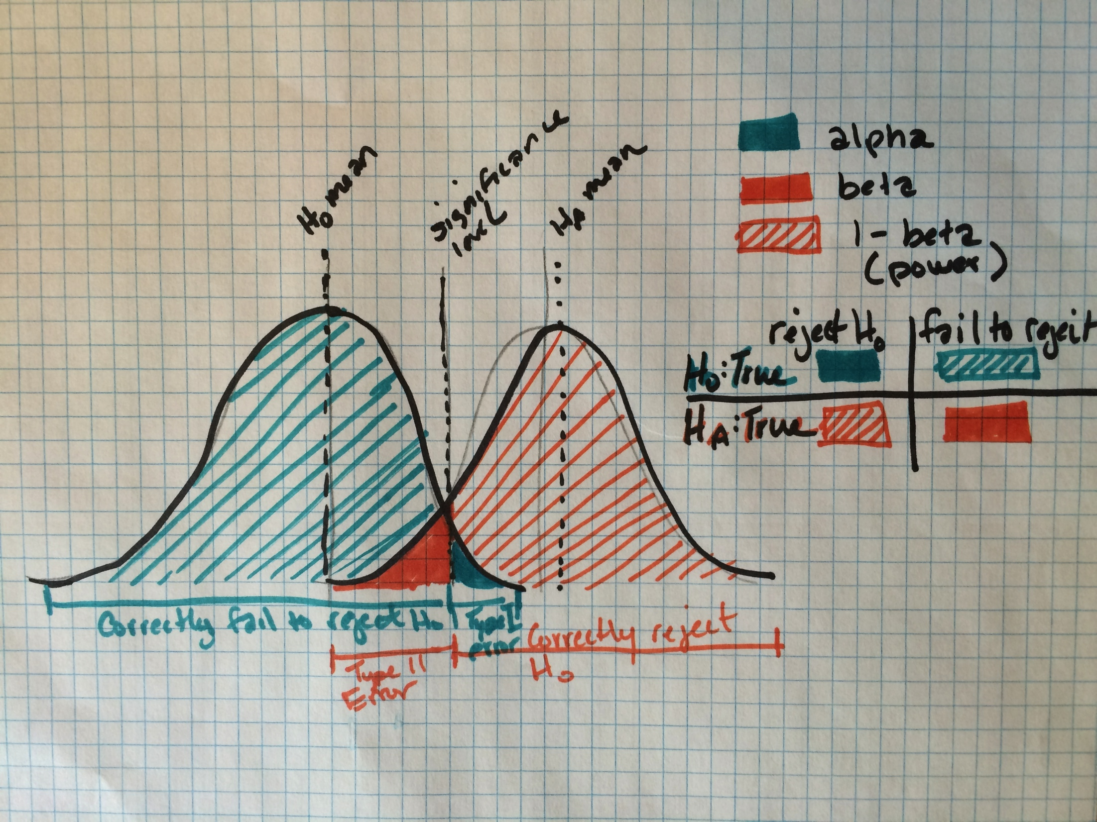

Slide 8
When the null hypothesis is true
1-sample t-test
n = 25

Slide 9
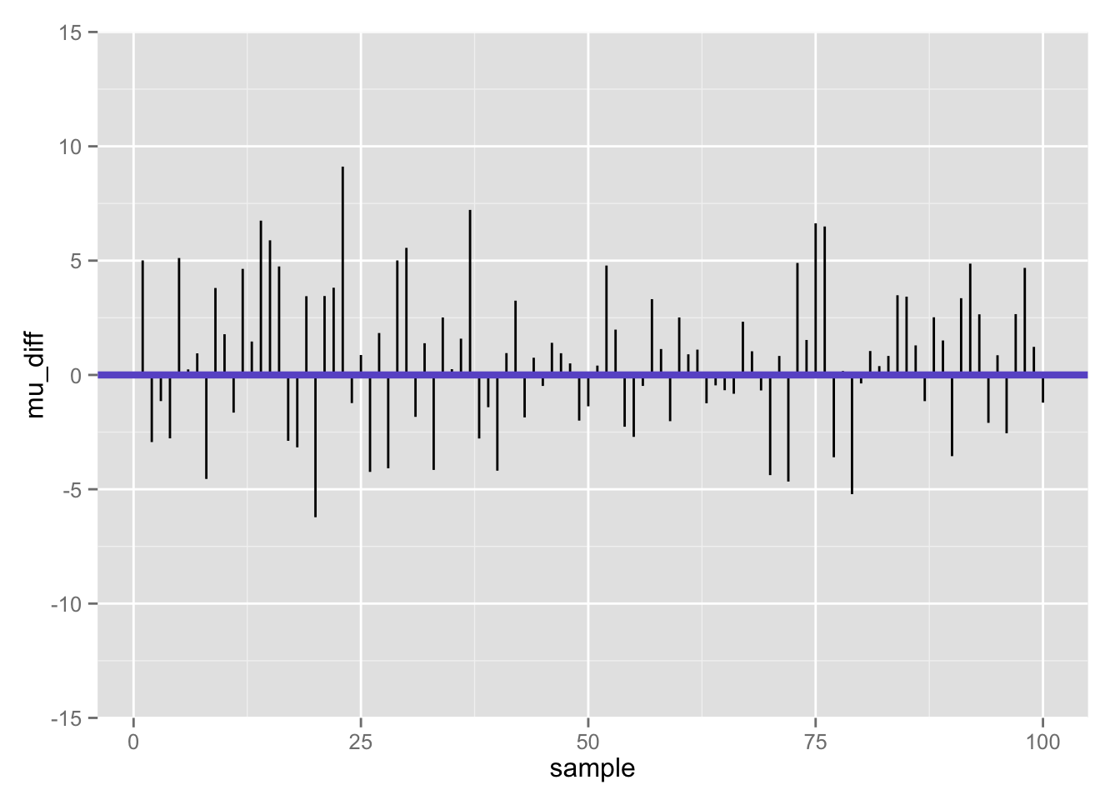
Differences between population mean and sample mean (100 samples) when null is true

Slide 10
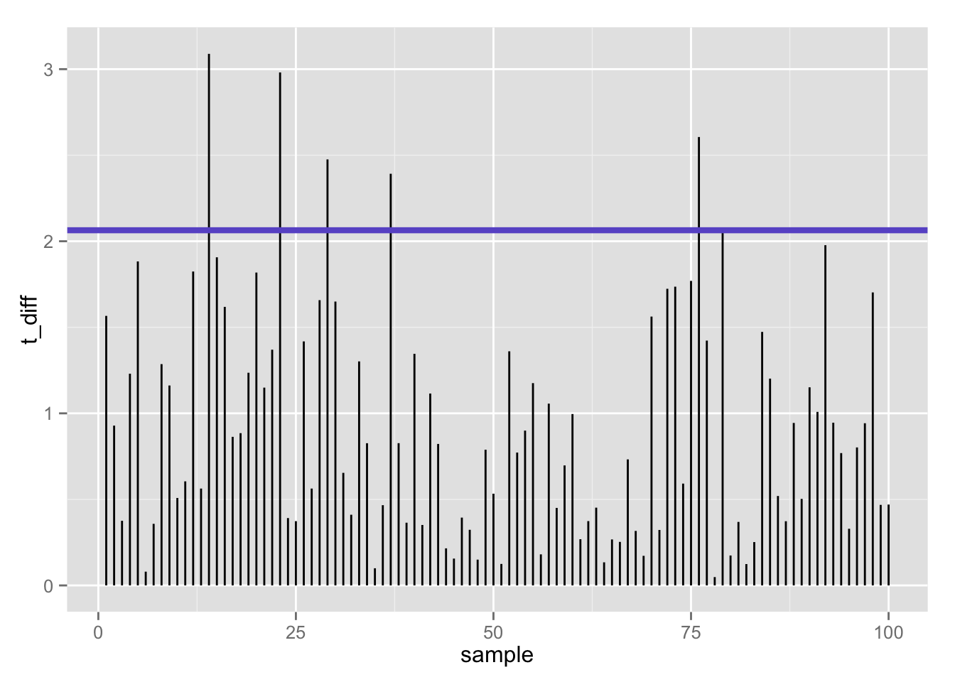
100 t-statistics (absolute value) when null is true: 5% false positives using t-test (𝛂 = .05/2)

Slide 11
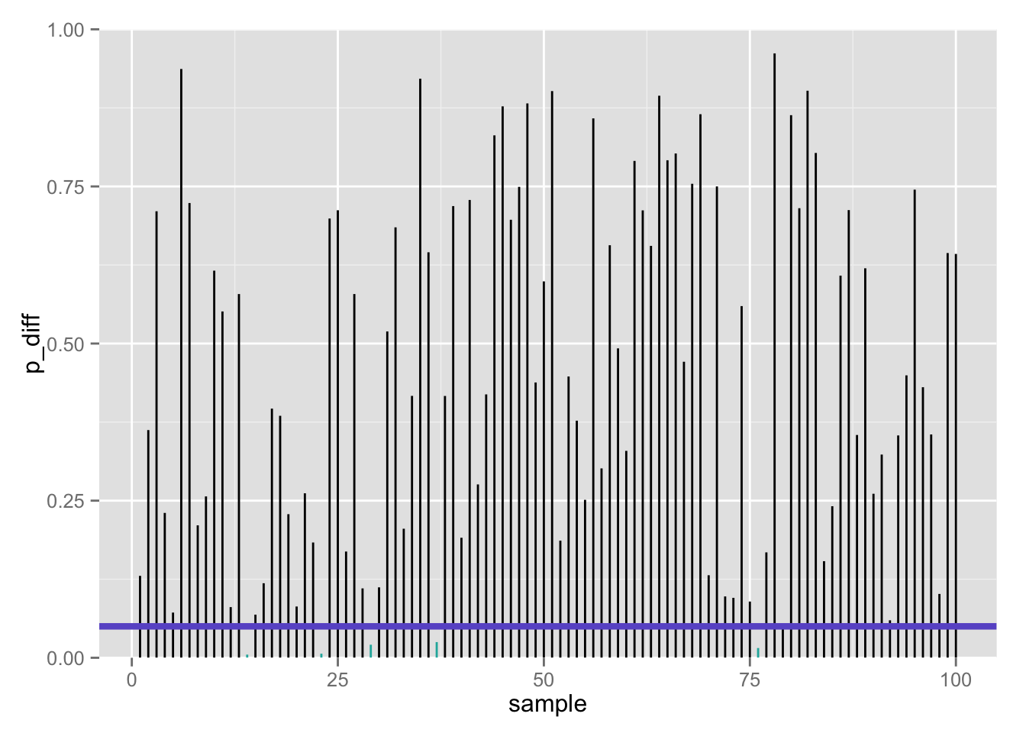
100 p-values when null is true: 5% false positives using t-test (𝛂 = .05/2)

Slide 12

Confusion matrix
 | Call based on observed data
True state of the world | Fail to reject H₀ | Reject H₀
H₀ | True negative 1 – 𝝰 | False positive Type I error 𝝰 | # true H₀’s
H₁ | False negative Type II error 𝛃 | True positive 1 – 𝛃 | # true H₁’s
 |  | # rejected H₀’s | # total tests
If the null is true…

Slide 13
Confusion matrix
 | Call based on observed data
True state of the world | Fail to reject H₀ | Reject H₀
H₀ | True negative 1 – 𝝰 | False positive Type I error 𝝰 | # true H₀’s
H₁ | False negative Type II error 𝛃 | True positive 1 – 𝛃 | # true H₁’s
 |  | # rejected H₀’s | # total tests
But… what if we are wrong??

Slide 14


Two ways we can be wrong…
Type 1 error (𝛂)
False positive
Type II error (𝛃)
False negative
“You’re not pregnant”
“You’re pregnant”

Slide 15
One way we can be wrong…
Type 1 error (𝛂)
False positive
Call: reject H₀
If we had rejected the null, it is of course possible that we should not have!
That is, the true state of the world may be H₀ (he’s not pregnant), but our sample data leads us to reject H₀ and (incorrectly) conclude that he’s pregnant
This is really embarrassing, so we control this: 𝛂 = ?
“You’re pregnant”

Slide 16
The other way we can be wrong…
Call: fail to reject H₀
Type II error (𝛃)
False negative
If we conclude that we cannot reject the null, it is of course possible that we should have!
That is, the true state of the world may be H₁ (she’s pregnant), but our sample data says we don’t have good enough evidence to reject H₀ (she’s not pregnant)
“You’re not pregnant”

Slide 17
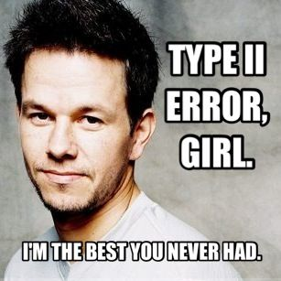
Type II errors
The one(s) that got away…

Slide 18







In our aspiring astronauts example…
Type 1 error (𝛂)
False positive
Type II error (𝛃)
False negative
Decide:
“You are smarter than average!”
Reality:
but you are actually not
Decide:
“You’re not smarter than average!”
Reality:
but you are actually

Slide 19

The boy who cried wolf caused both Type I and Type II errors, in that order.
First, everyone believed there was a wolf, when there actually was not a wolf.
Next, they believed there was no wolf, when there actually was a one.
Substitute “effect” for “wolf” - done!
Thanks to @danolner and @JustinWolfers for this one

Slide 20
What if: the null hypothesis is FALSE?
1-sample t-test
n = 25

Slide 21
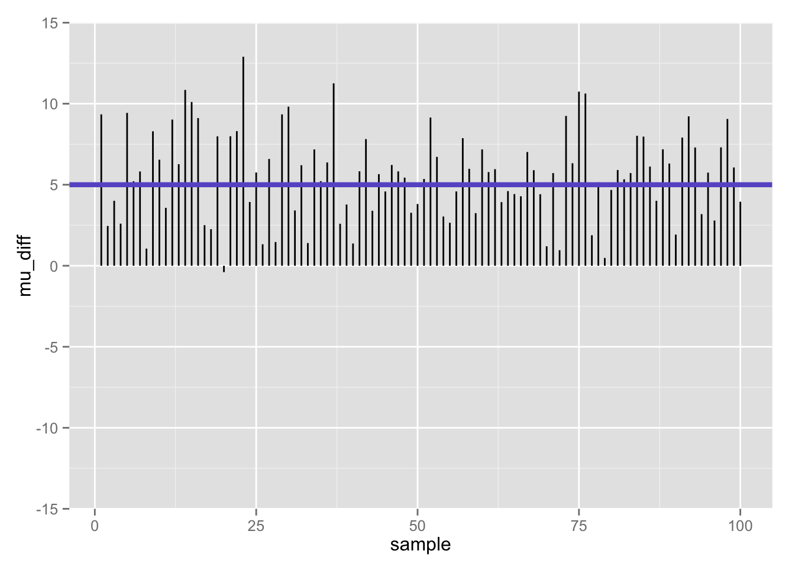
Differences between population mean and sample mean (100 samples) when null is false

Slide 22
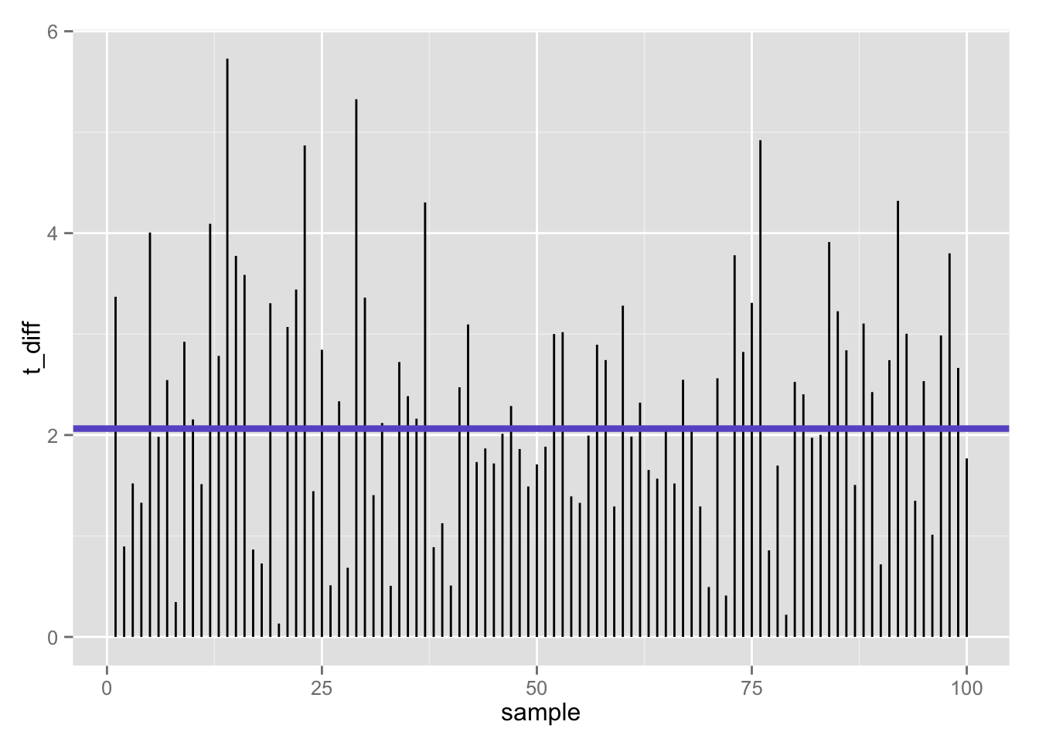
100 t-statistics (absolute value) when null is false: 47% false negatives using t-test (𝛂 = .05/2)
Flip side (1 −𝛃):
53% true positives

Slide 23
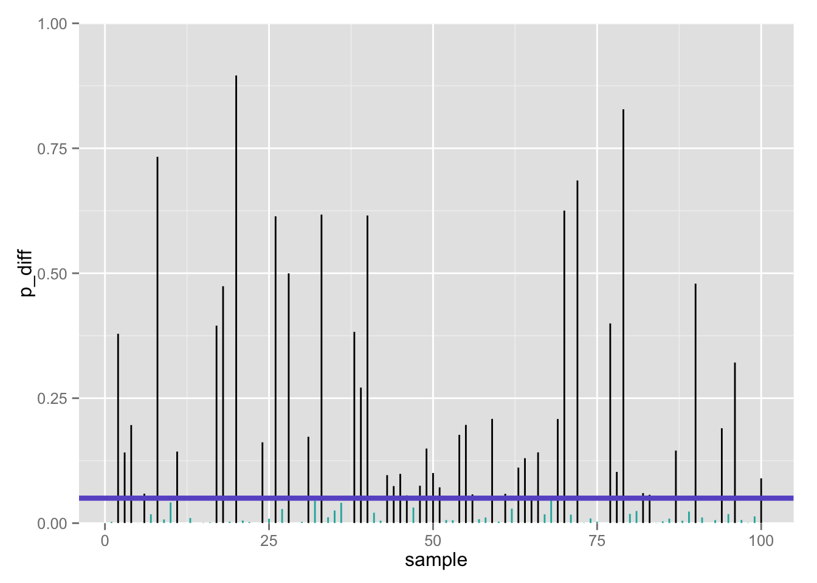
100 p-values when null is false: 47% false negatives using t-test (𝛂 = .05/2)
Flip side (1 −𝛃):
53% true positives

Slide 24

≈ 50% true positives seems low…
Only about half of our true effects would be detected in our study
Why?
Perhaps we lacked statistical power

Slide 25
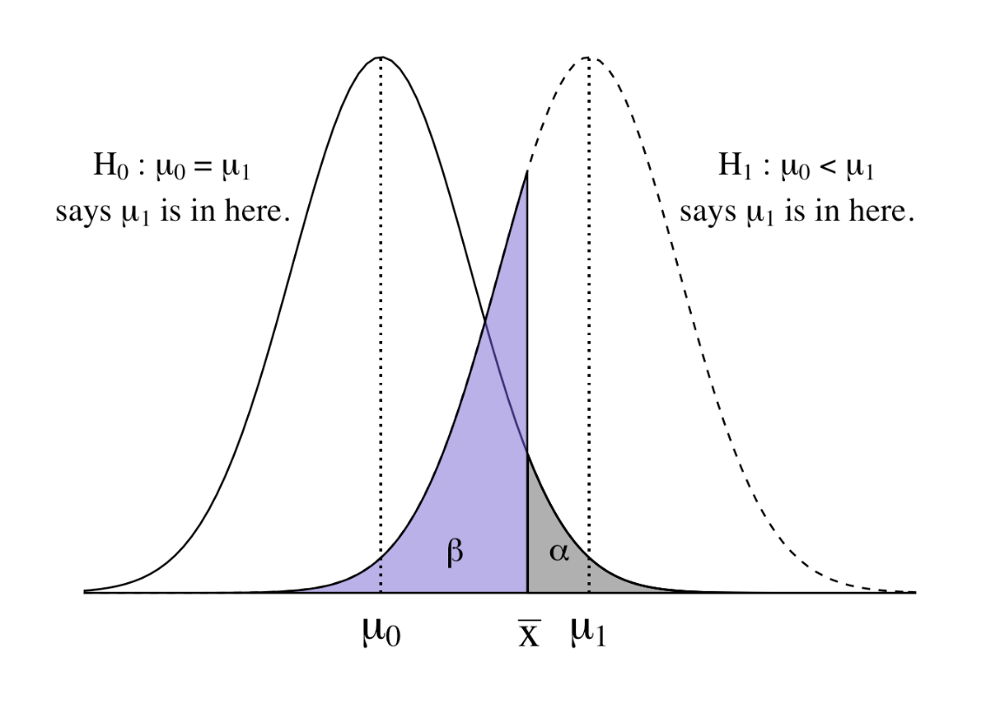
Dueling distributions
In a one-tailed test, we have two dueling hypothetical distributions:
The null distribution, centered at µ₀
The alternative distribution, centered around some specific or unspecified other mean (higher or lower?) µ₁

Slide 26
What if: the null hypothesis is FALSE?
1-sample z-test
n = 25

Slide 28
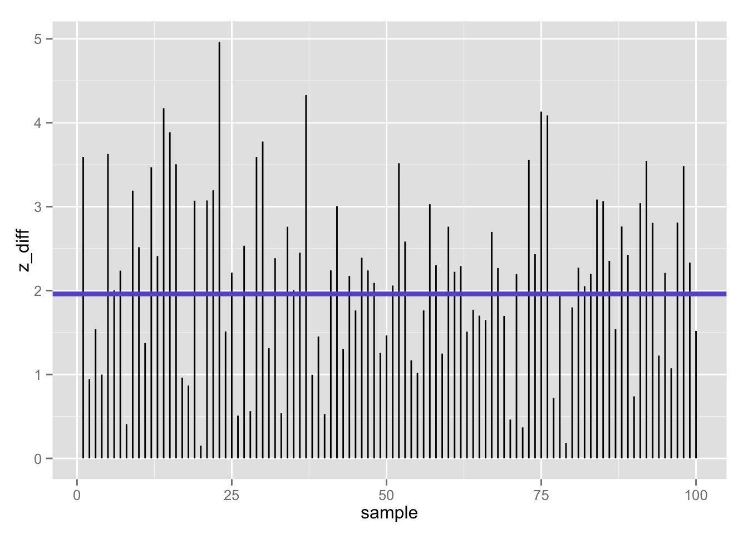
100 z-statistics (absolute value) when null is false: 39% false negatives using z-test (𝛂 = .05/2)
Flip side (1 −𝛃):
61% true positives

Slide 29
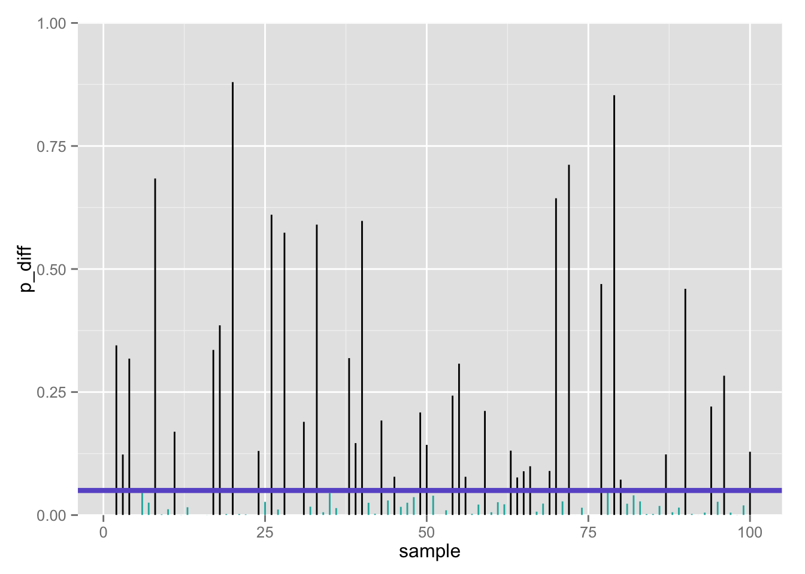
100 p-values when null is false: 39% false negatives using z-test (𝛂 = .05/2)
Flip side (1 −𝛃):
61% true positives

Slide 30
Power
Power is the probability of correctly rejecting a false null hypothesis
Suppose we wish to test (α = .025, 1-tailed):
H₀: μ ≤ 100
H₁: μ > 100
Let’s use the same sample of n=25 aspiring astronauts (we know σ = 15)
First, what is β?

Slide 31
Let’s do a one-tailed t-test…
> aat_1 <- t.test(iq_aa, mu = 100, alternative = c("greater"))
> aat_1
One Sample t-test
data: iq_aa
t = 1.9227, df = 24, p-value = 0.03323
alternative hypothesis: true mean is greater than 100
95 percent confidence interval:
100.5509 Inf
sample estimates:
mean of x
105
One-tailed test

Slide 32
If the null is true…
The test statistic under the null will have a central t distribution with ν = n − 1 = 24 degrees of freedom.
The (one-tailed) critical value will be:
> qt(.95, 24) # t_{critical}, null dist
[1] 1.710882
P(false positive) = 𝝰 = Type I error rate = .05
P(false negative) = 𝛃 = Type II error = ?
P(true positive) = 1 − 𝛃 = power = ?
One-tailed test

Slide 33
Finding 𝛃 (and 1 − 𝛃)
Need to know exact null distribution (just as with NHST)
Also need to know exact alternative distribution of the test statistic
Often requires some specialized statistical knowledge
In general, it is much more likely that expressions for the null distribution of the test statistic will be available than expressions for the non-null distribution.

Slide 34
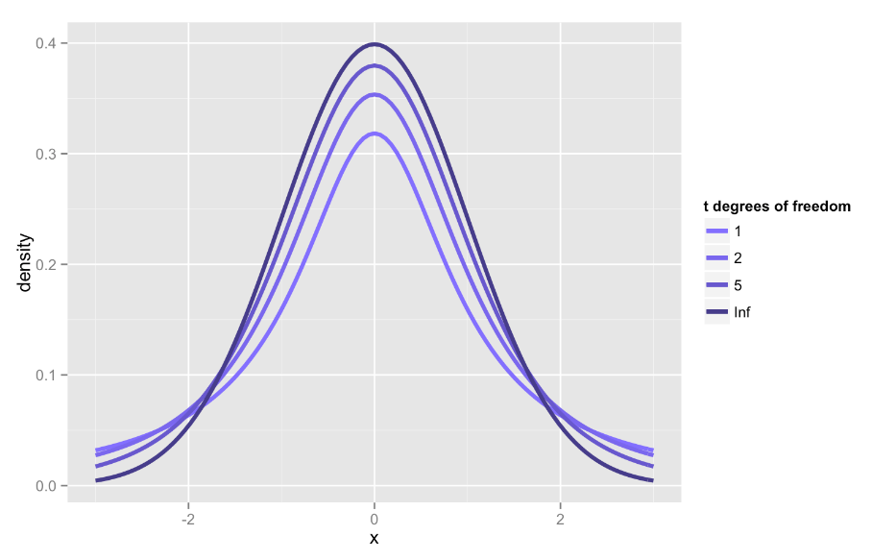
Recall student’s t-distribution

Slide 35
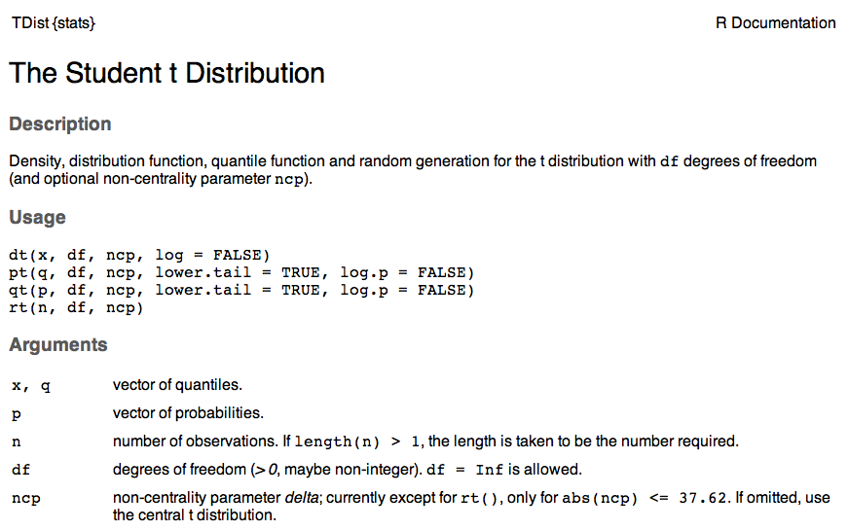

Slide 36
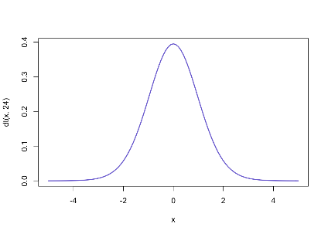
Central t-distribution (ν= degrees of freedom)
𝝳 = 0
Mean = 0
Variance slightly > than N(0, 1)
Kurtosis (biased) is > 3
Symmetric

Slide 37
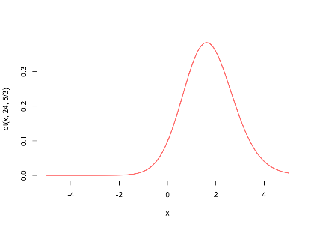
Noncentral t distribution (ν= degrees of freedom)
𝝳 ≠ 0
Asymmetric: skewed in the direction of 𝝳
Notes:
E(T) = \begin{cases}
\delta \sqrt{\frac{\nu}{2}} \frac{\Gamma((\nu - 1)/2)}{\Gamma(\nu/2)} & \text{if }\nu > 1 \\
\text{Does not exist} & \text{if }\nu \leq 1
\end{cases}

Slide 38
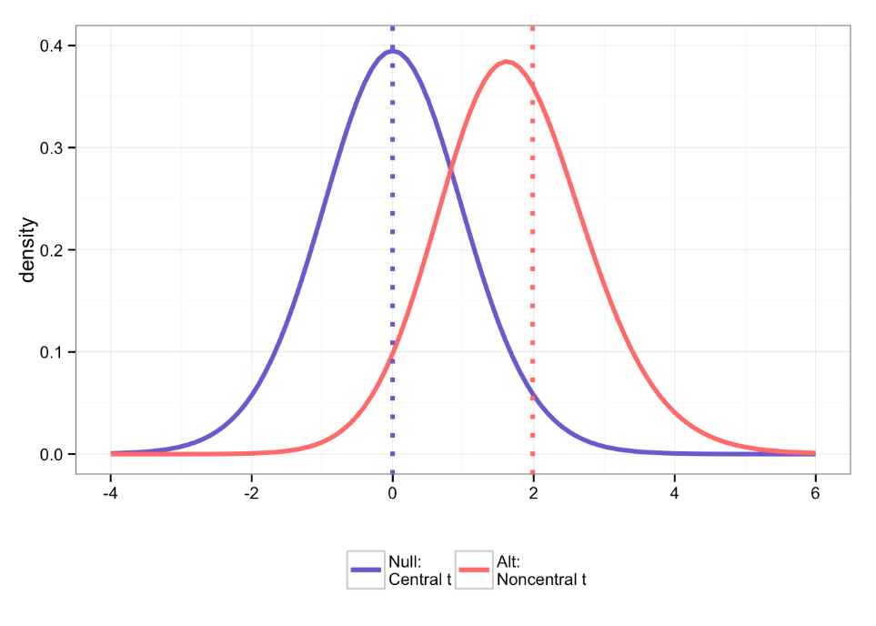
One-tailed test

Slide 39
How do we calculate the ncp?
The noncentrality parameter (ncp) is defined as:
Where E_{s} is the standardized measure of effect size…how do we calculate this?

Slide 40
Effect size
What is not in this formula?

Slide 41
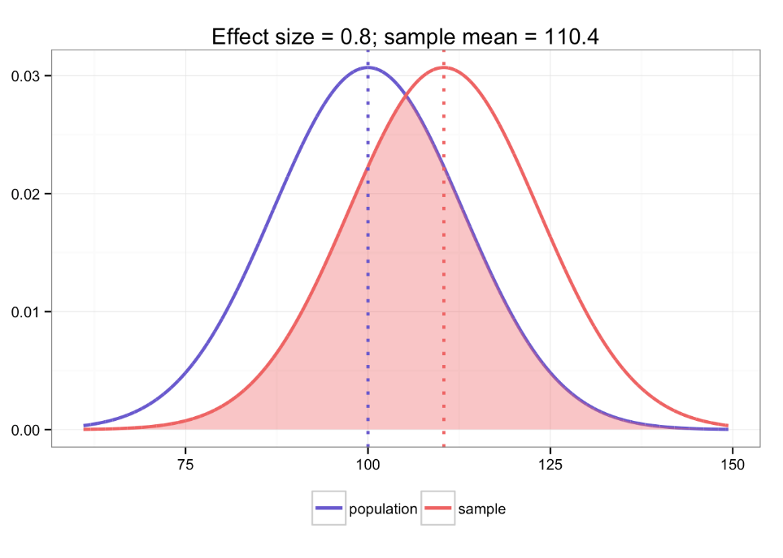

Slide 42
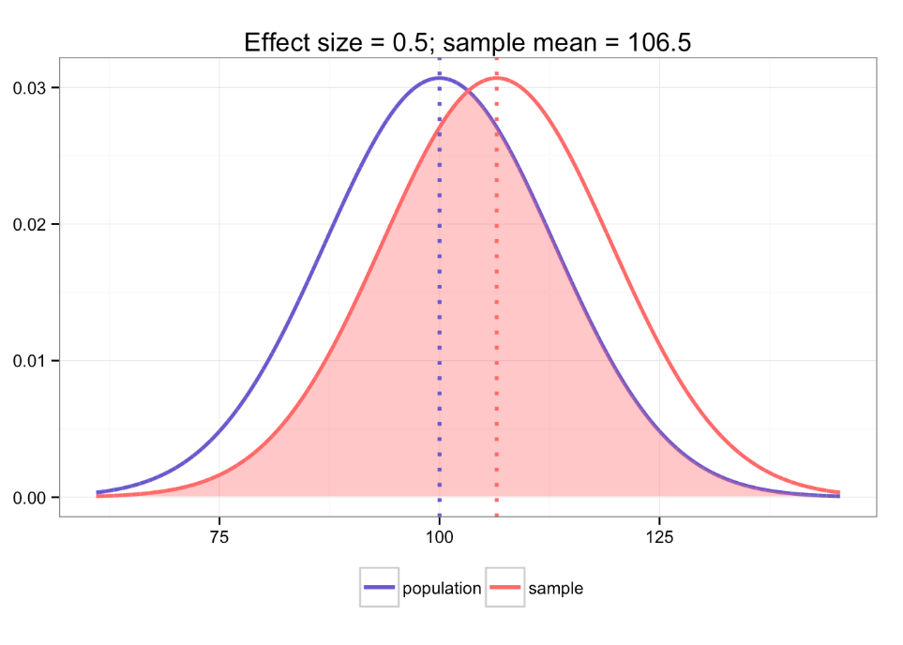

Slide 43
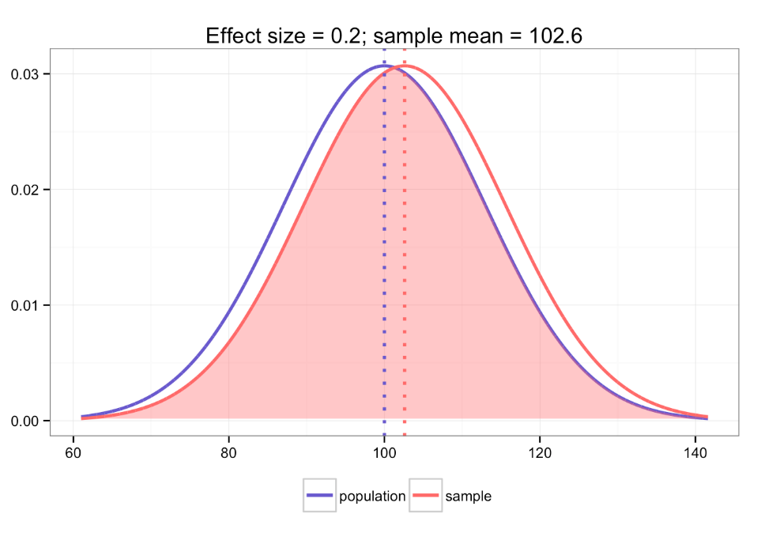

Slide 44
Calculating effect size and ncp
In our example, the E_{s} is defined just by the sample mean, null mean, and the sample s.d., so the ncp is:

Slide 45
The null and alternative t-distributions
Use alternative distribution to solve for 𝛃

Slide 46
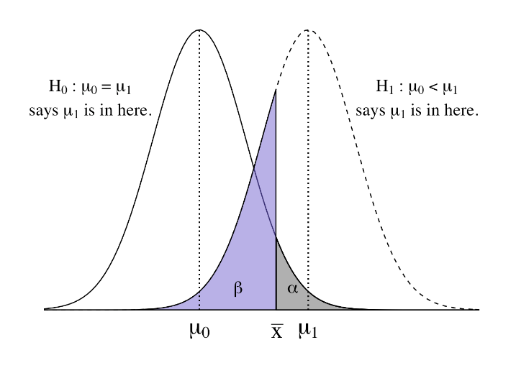
TYPE II ERROR: p(false negative) = 𝛃

Slide 47
TYPE II ERROR: p(false negative) = 𝛃
For a given decision,
P(false positive) = 𝝰 = Type I error
P(false negative) = 𝛃 = Type II error
What will happen to 𝛃 if I make 𝝰 smaller?

Slide 48
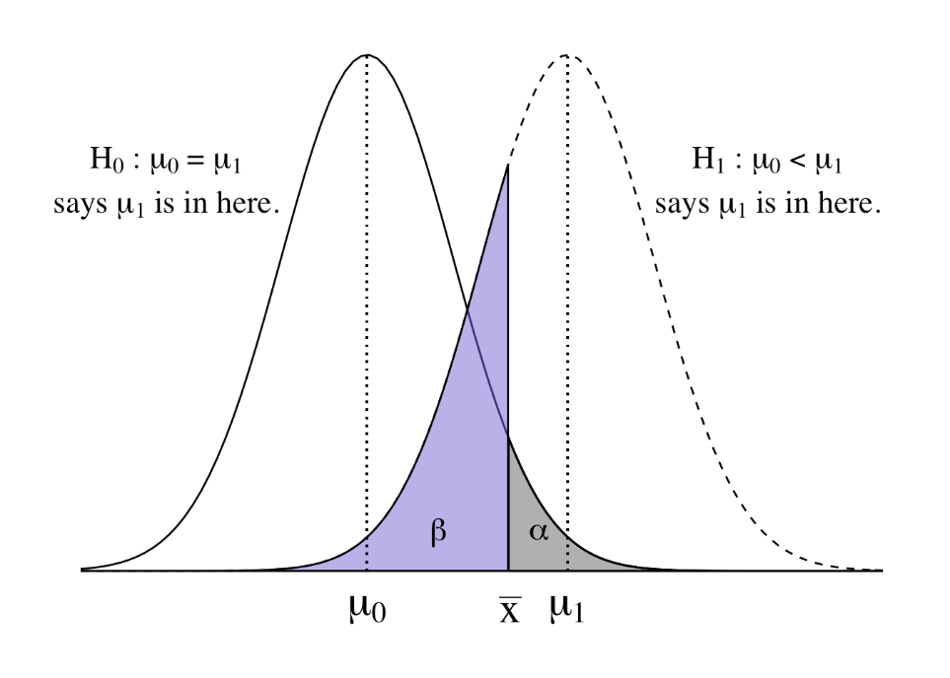
What will happen to 𝛃 if I make 𝝰 smaller?

Slide 50
TYPE II ERROR: p(false negative) = 𝛃
Probability is defined as the chances of observing a t-statistic more extreme than the one we observed given the alternative t-distribution
“How much more wrong could we have been?”

Slide 51
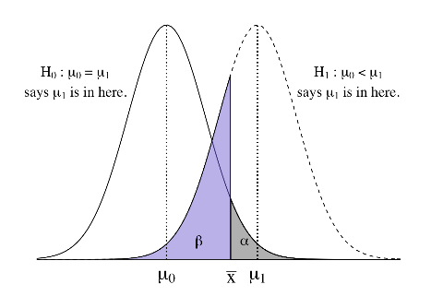
In our aspiring astronauts example…
qt(.95, 24)
[1] 1.710882
pt(qt(0.95, 24), 24, 25/13)
[1] 0.4115342 # beta
Type II error (𝛃)
False negative
Decide:
“You’re not smarter than average!”
Reality:
but you are actually

Slide 52
POWER: p(true positive) = 1 − 𝛃
So power is the probability of exceeding the rejection point in this noncentral t distribution.
qt(.95, 24) # t_{critical}, null dist
[1] 1.710882
pt(qt(0.95, 24), 24, 25/13) # beta
[1] 0.4115342
1 - pt(qt(0.95, 24), 24, 25/13) # power
[1] 0.5884658
One-tailed test

Slide 53
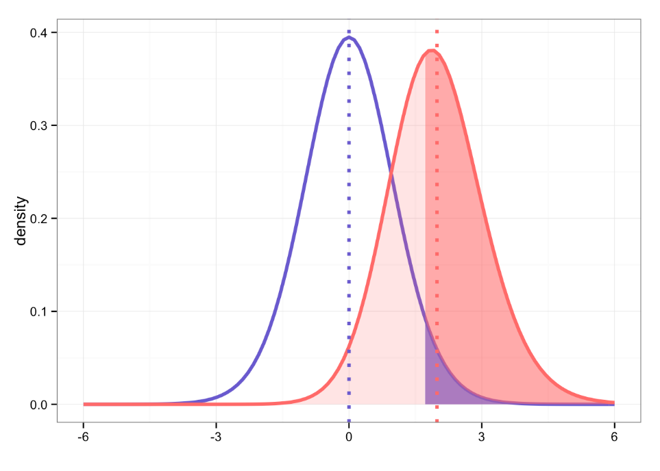
Where are:
𝝰, 𝛃, power?

Slide 54
Power
power.t.test(n = 25, delta = 5, sd = 13, type = "one.sample", alternative = c("one.sided"))
One-sample t test power calculation
n = 25
delta = 5
sd = 13
sig.level = 0.05
power = 0.5884658
alternative = one.sided
Good for: “post-mortem” power analysis
One-tailed test
delta here is confusing: it is neither the ncp nor the effect size- it is the raw difference between means you wish to detect

Slide 55
Factors that affect Power (1 – 𝛃)
Sample size
Increased n reduces SE_{mean}
Level of significance
Power increases as 𝝰 increases
Reliability of your measure
Classical test theory: total variance = true score variance + error variance
Effect size (sds between the true mean & the one hypothesized in H₀; µ − µ₀ )
Population variance
Decreased variance reduces SE_{mean}

Slide 56
Power
For a given decision,
P(false positive) = 𝝰 = Type I error
P(true positive) = 1 − 𝛃 = power
What will happen to 1 − 𝛃 (power) if I make 𝝰 smaller?

Slide 57
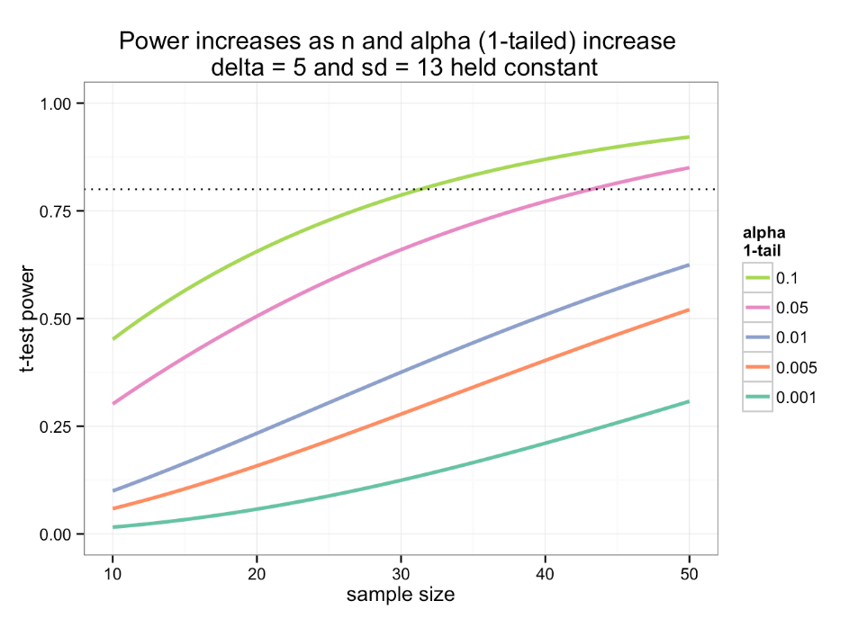

Slide 58
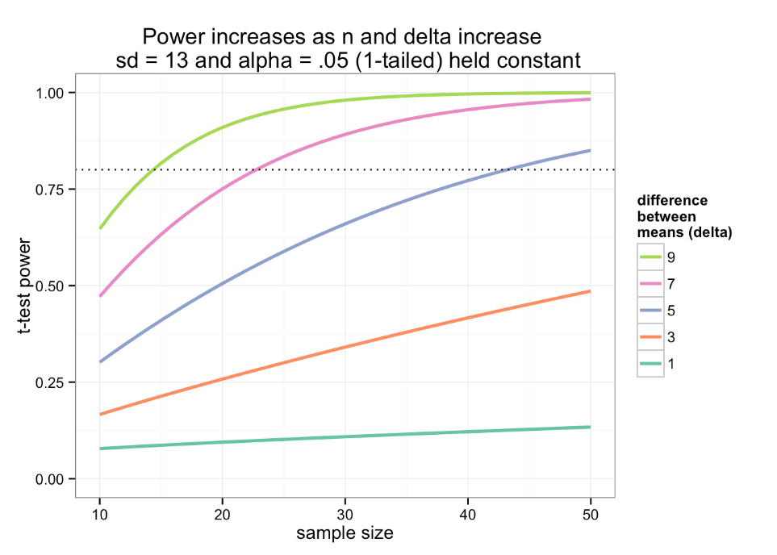

Slide 59
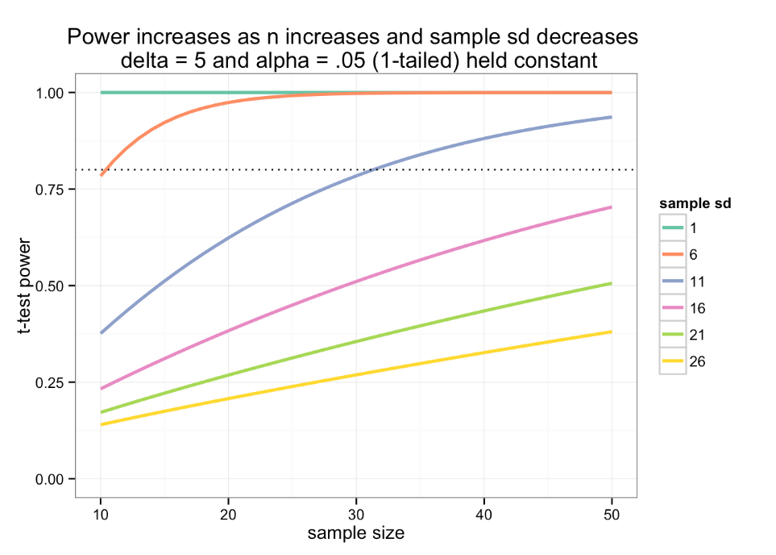

Slide 60

How large would our “n” have to be?
To detect:
Δ= 5
1 − 𝛃 = .80
𝝰 = .05
With s.d. = 13
Good for: a priori sample size determination
One-tailed test

Slide 61
Sample size determination
power.t.test(n = NULL, delta = 5, sd = 13, sig.level = .05, power = .80, type = "one.sample", alternative = c("one.sided"))
One-tailed test

Slide 62
Sample size determination
power.t.test(n = NULL, delta = 5, sd = 13, sig.level = .05, power = .80, type = "one.sample", alternative = c("one.sided"))
One-sample t test power calculation
n = 43.17957
delta = 5
sd = 13
sig.level = 0.05
power = 0.8
alternative = one.sided
One-tailed test

Slide 63
Sample size determination
power.t.test(n = NULL, delta = 5, sd = 13, sig.level = .05, power = .80, type = "one.sample", alternative = c("one.sided"))
One-sample t test power calculation
n = 43.17957
delta = 5
sd = 15
sig.level = 0.05
power = 0.8
alternative = one.sided
One-tailed test

Slide 64
How small of an effect could we detect…
If we knew we could get:
n = 100 high school girls who are aspiring astronauts
And we wanted:
1 − 𝛃 = .80
𝝰 = .05
With s.d. = 13
One-tailed test

Slide 65
Sample size determination
power.t.test(n = 100, delta = NULL, sd = 13, sig.level = .05, power = .80, type = "one.sample", alternative = c("one.sided"))
One-tailed test

Slide 66
Effect size determination
power.t.test(n = 100, delta = NULL, sd = 13, sig.level = .05, power = .80, type = "one.sample", alternative = c("one.sided"))
One-sample t test power calculation
n = 100
delta = 3.254735
sd = 13
sig.level = 0.05
power = 0.8
alternative = one.sided
One-tailed test

Slide 67


Slide 68
Notes:
Type II error occurs anytime we fall in the region of non-rejection under null when in fact we are drawing from a different population with a different mean
Panel c: assume null is false, m is equal to 104
Power = 1 – beta
Type II error: do not reject a false null hypothesis (that is, reject a true alterative hypothesis)
So 1-Type II error = power = probability that I will CORRECTLY reject a null hypothesis

